Slide 1

231 Java SL NK - RLL - Group 4
Housekeeper Scheduling System

Slide 2

Group Members
Kriti Srivastava (Team Lead)
Katta Bujji
Lohith Gowda C V
Nithya X
Rachagolla Sireeshaa
Jampala Prakash Kumar
Burugadda Sushma
Balaji G

Slide 3
Table of contents
Introduction
Project agenda
Tools & Technologies
Project Architecture
ER-Diagram
Database Schema
Admin module
User module
Benefits
Future scope
Conclusion

Slide 4
Introduction
Housekeeper Scheduling System will be used by hostel students to request room cleaning services from assigned housekeepers.
This system will provide an admin portal and user portal.
By optimizing staff schedules and reducing room turnover time, this system improves staff efficiency.

Slide 5
Project Scope
Project agenda
The project scope for the Housekeeper Scheduling System encompasses the following key aspects and boundaries to ensure a well-defined and manageable development process:
To prepare DB schema and ER-diagram
Develop back-end
Perform functional testing
Develop front-end
Develop unit testing

Slide 6

Tools & Technologies
Front-End:
Angular
Back-End:
MYSQL
Server-side:
Spring Boot, Spring Data JPA
Web Server:
Tomcat

Slide 7
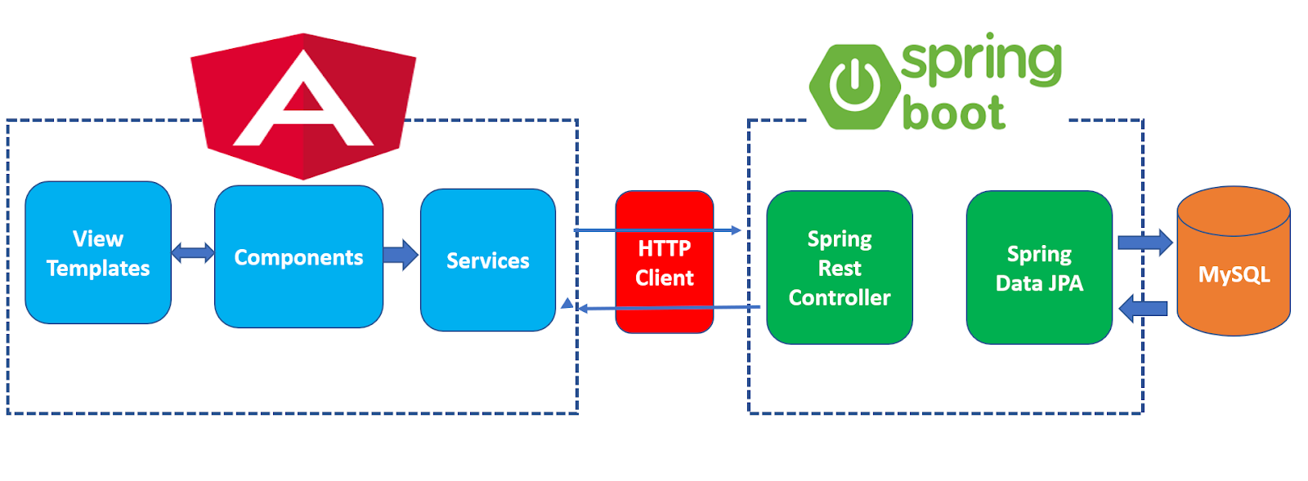
Project Architecture

Slide 8
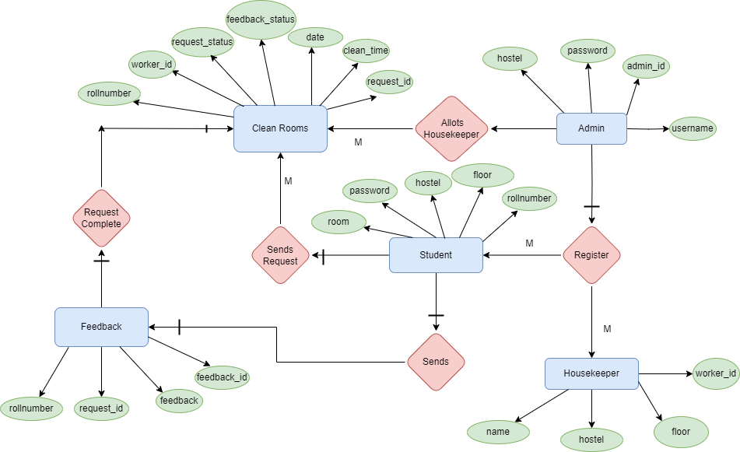
ER-Diagram

Slide 9
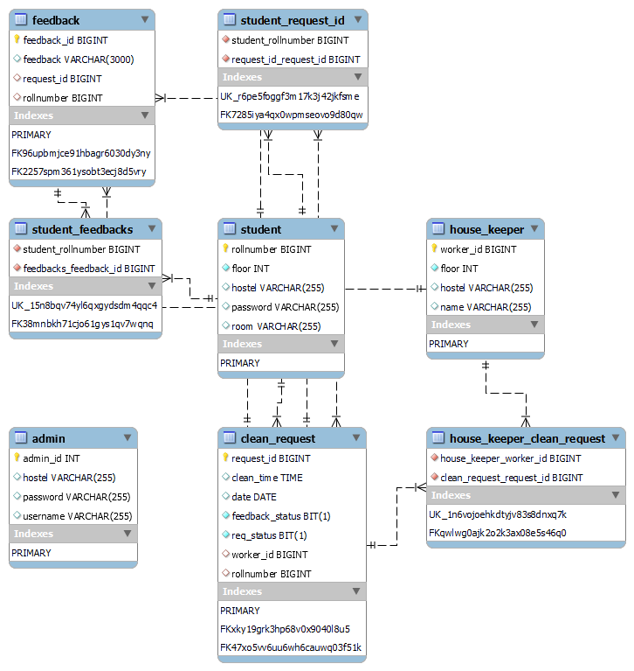
Database Schema

Slide 10


Admin & User module
Register student
Register housekeeper
Allot housekeeper
Feedback
Dashboard
Logout
Request
Feedback
Profile
Dashboard
Logout

Slide 11
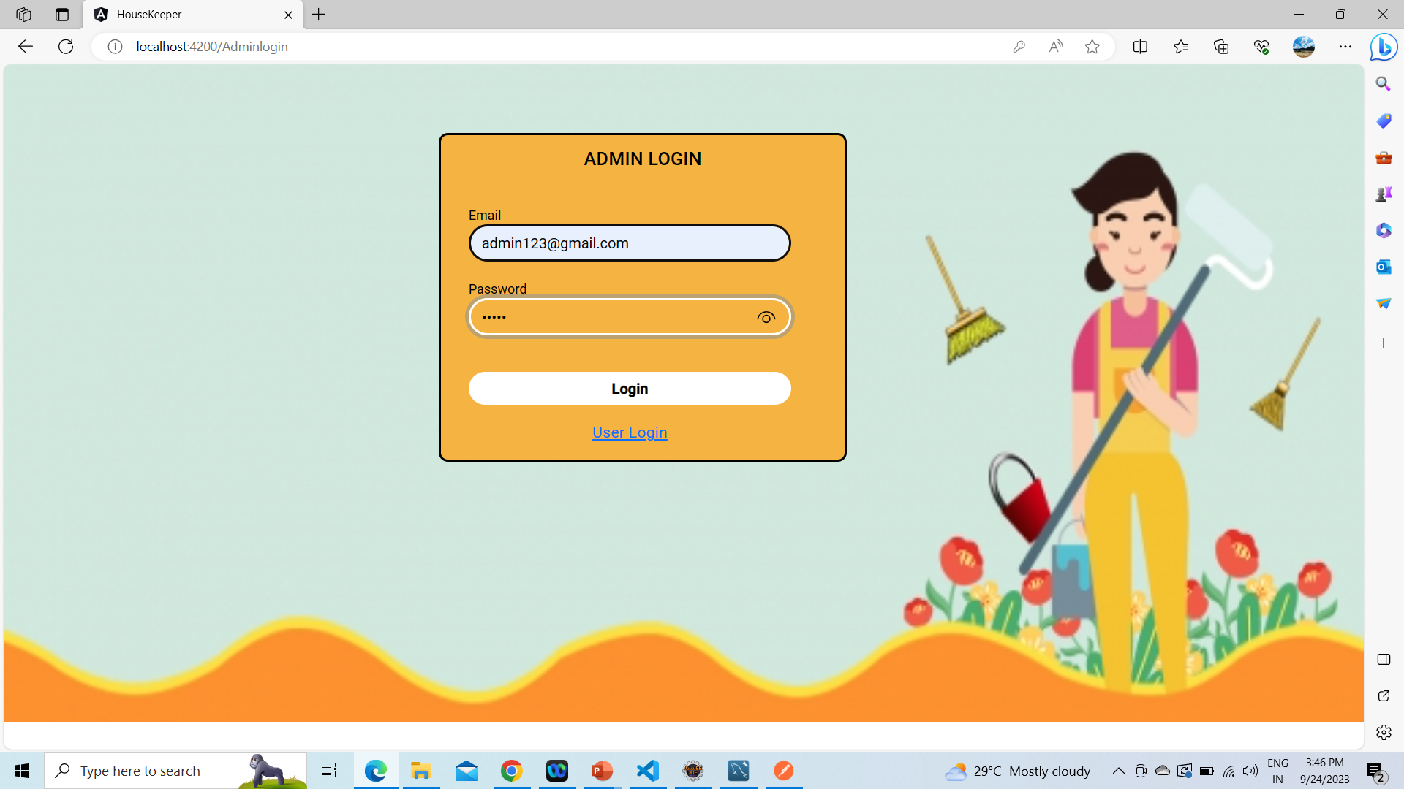
Output screenshots

Slide 12
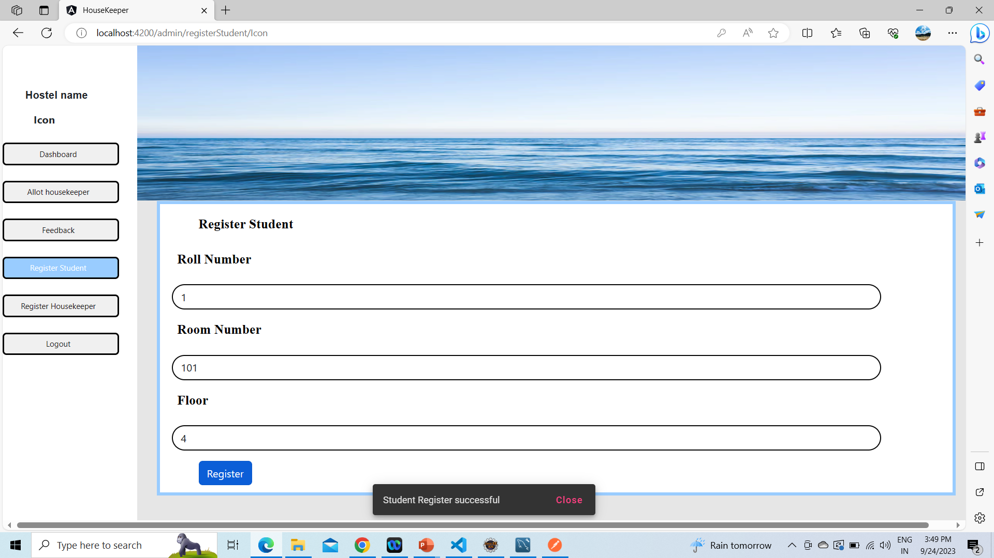

Slide 13
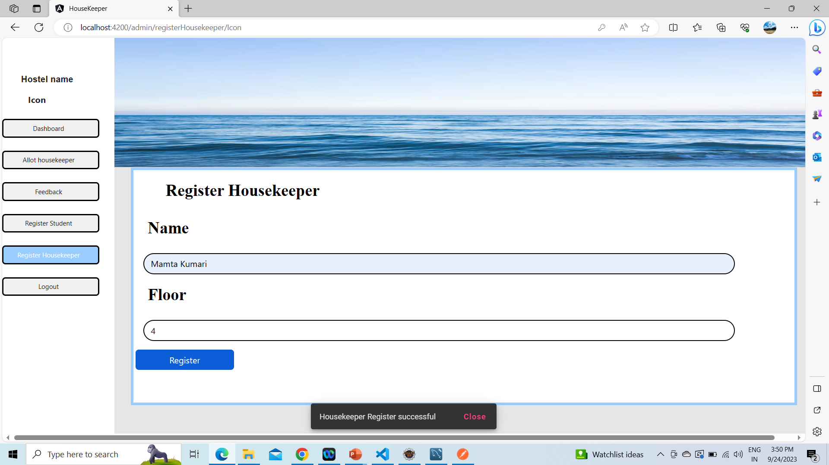

Slide 14
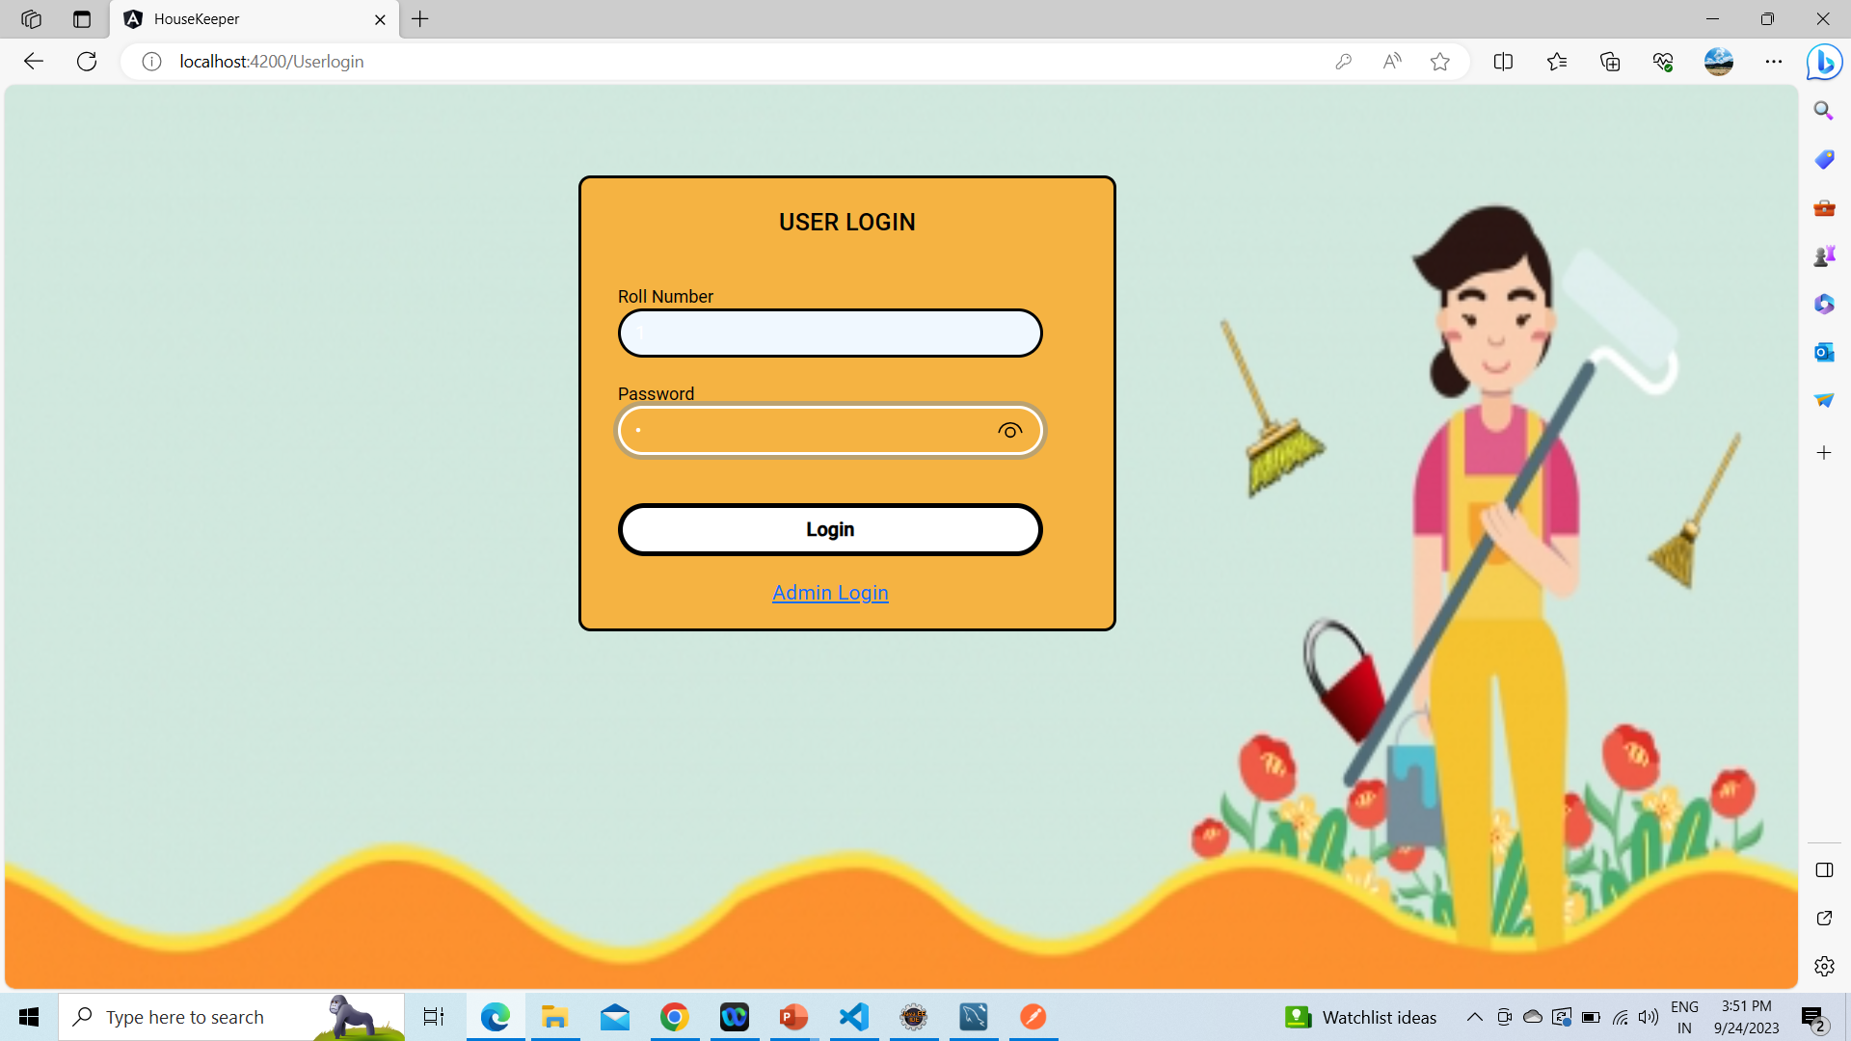

Slide 15
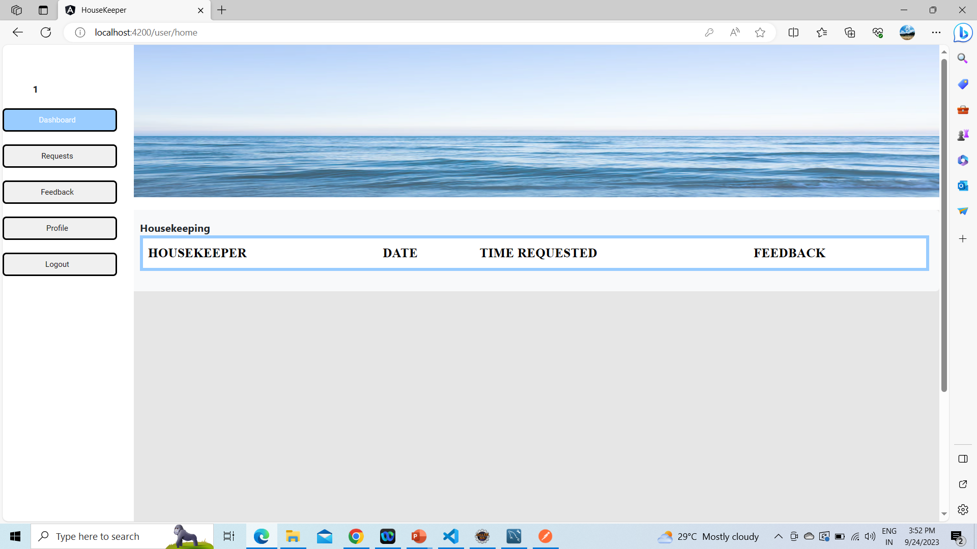

Slide 16
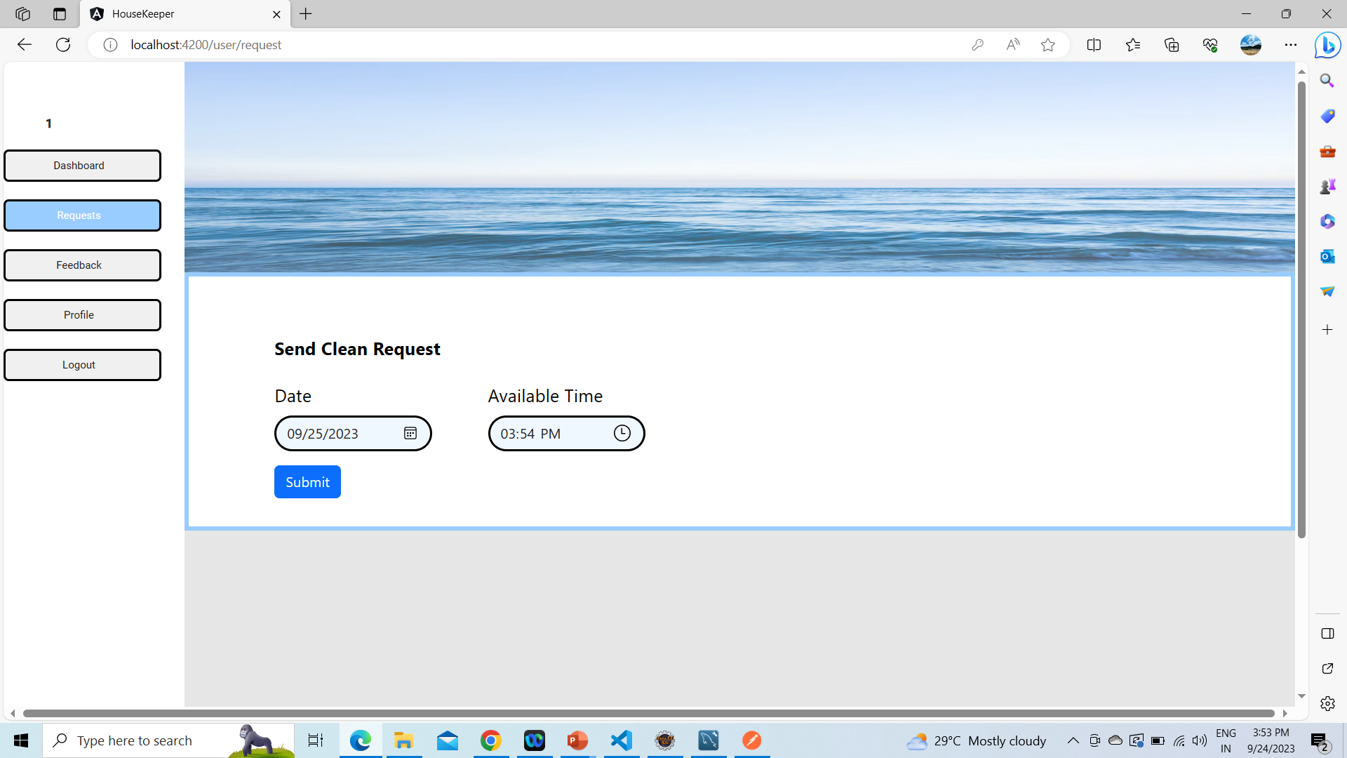

Slide 17
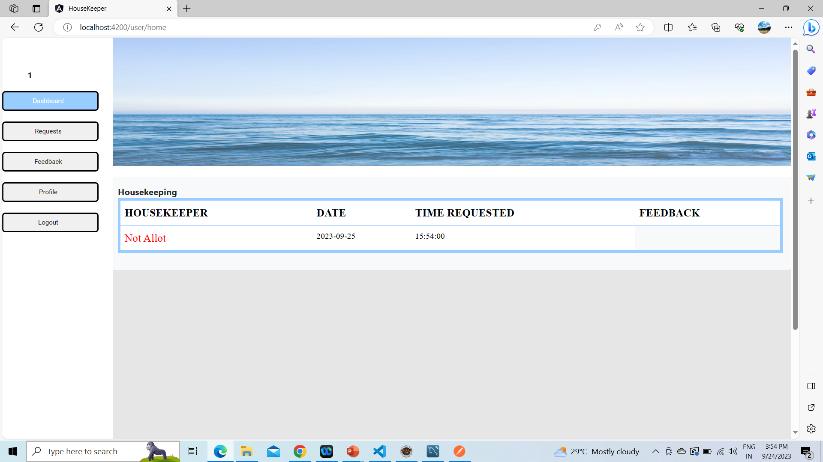

Slide 18
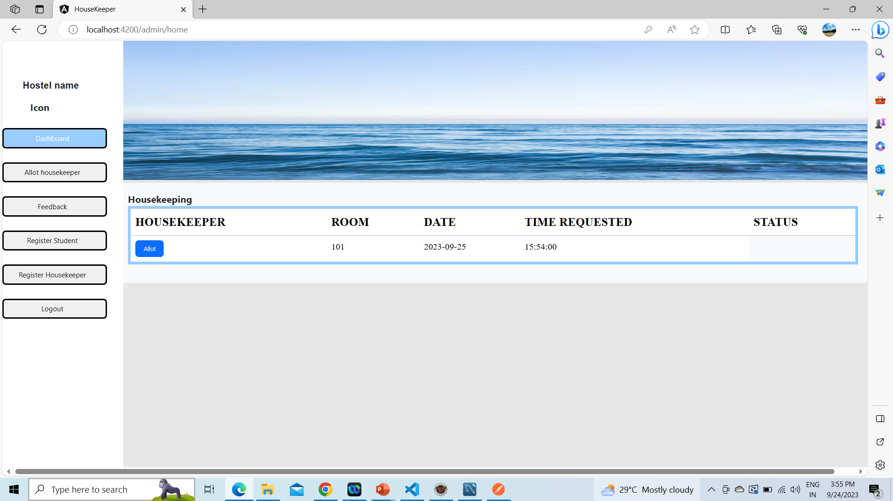

Slide 19
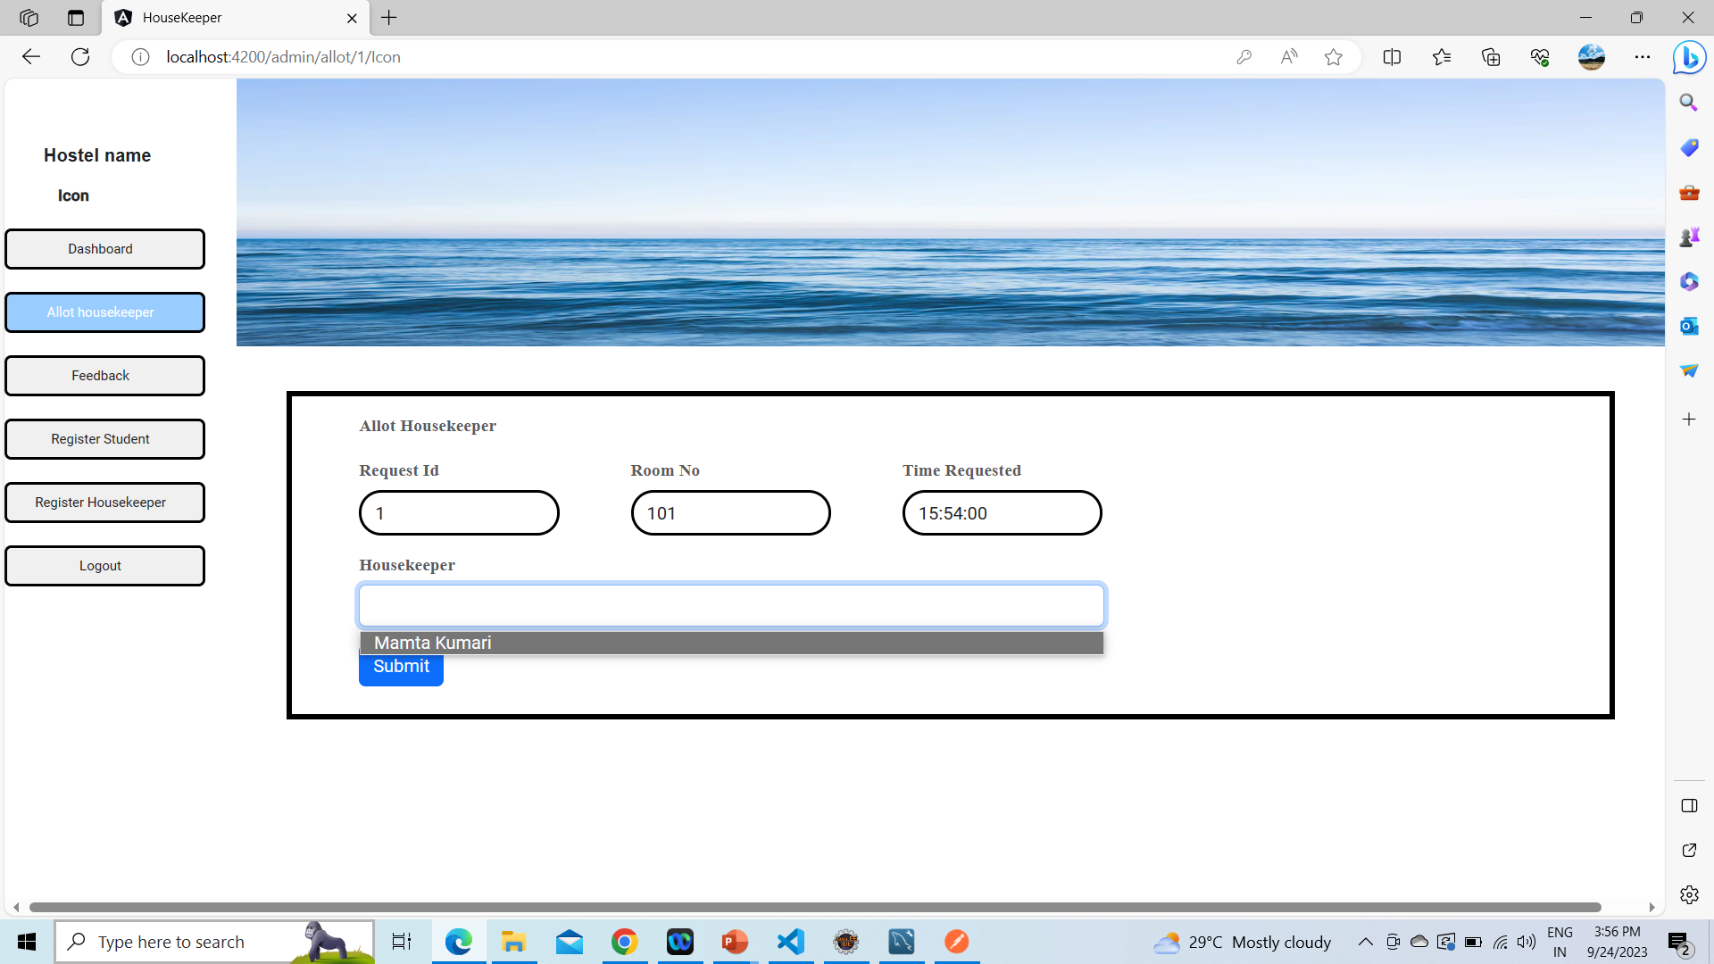

Slide 20
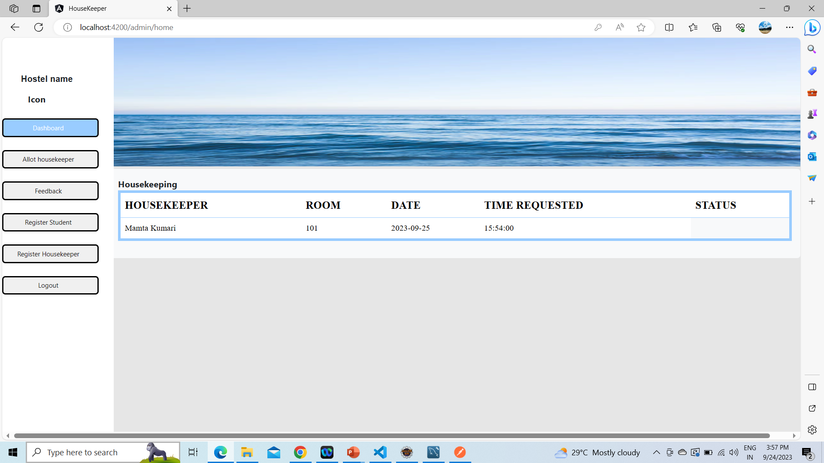

Slide 21
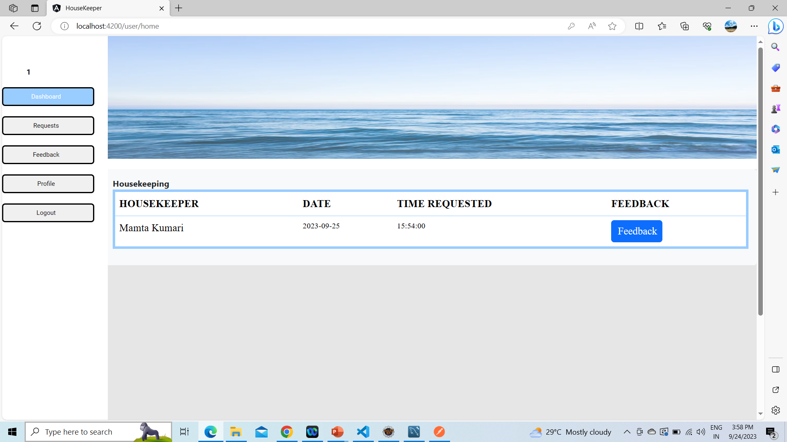

Slide 22
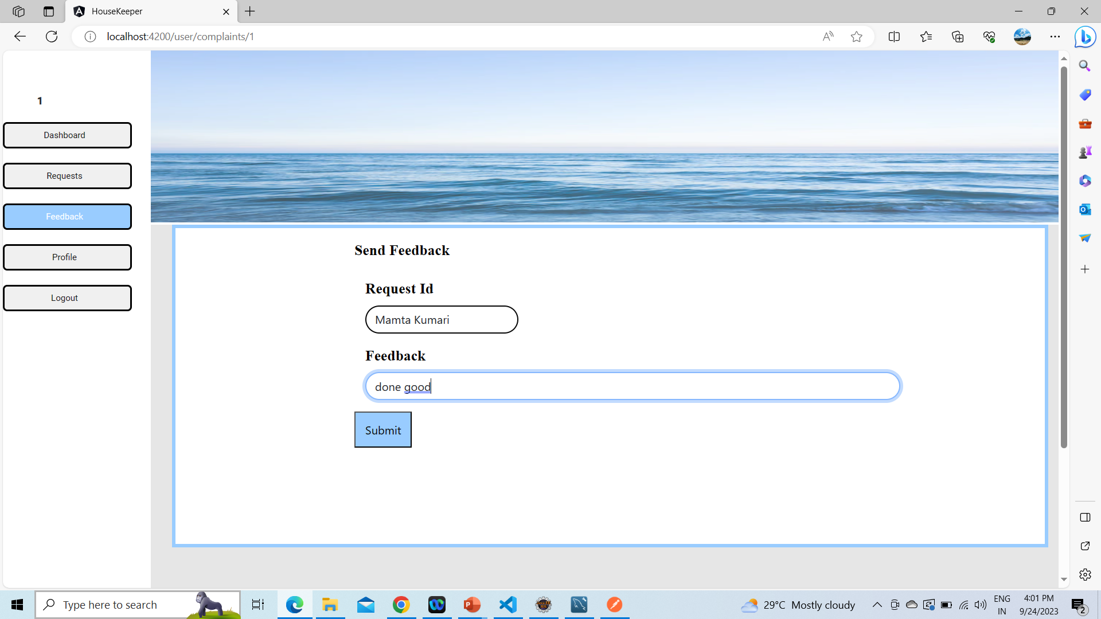

Slide 23
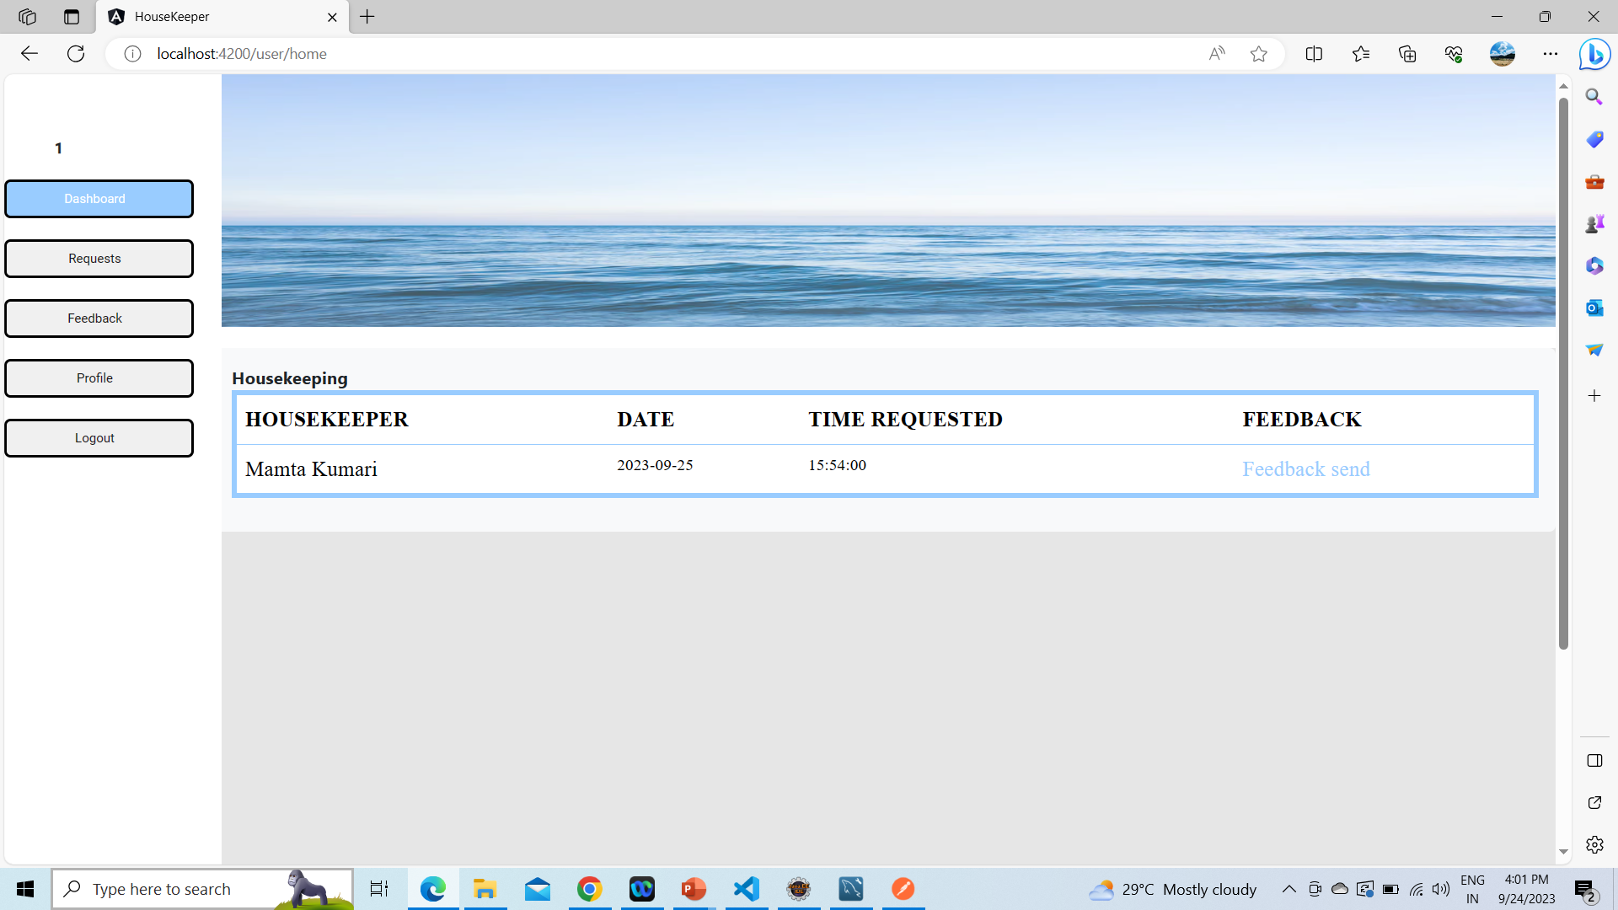

Slide 24
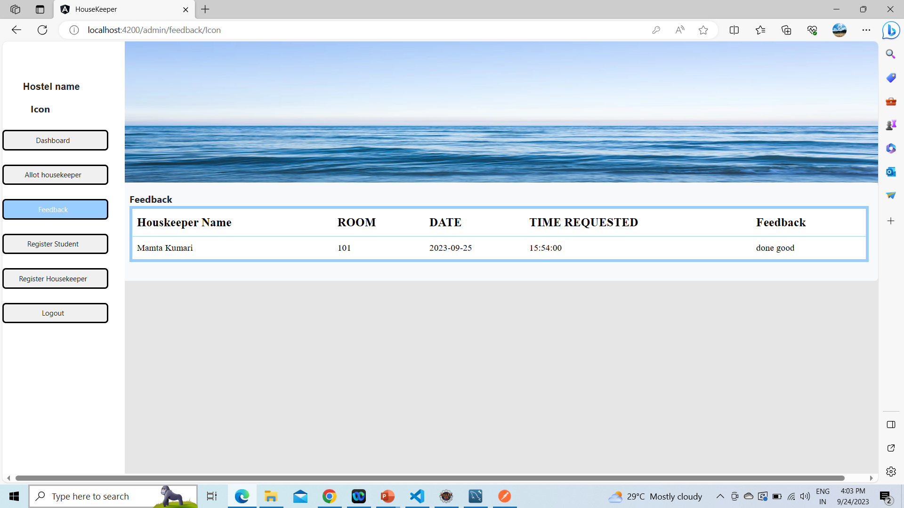

Slide 25
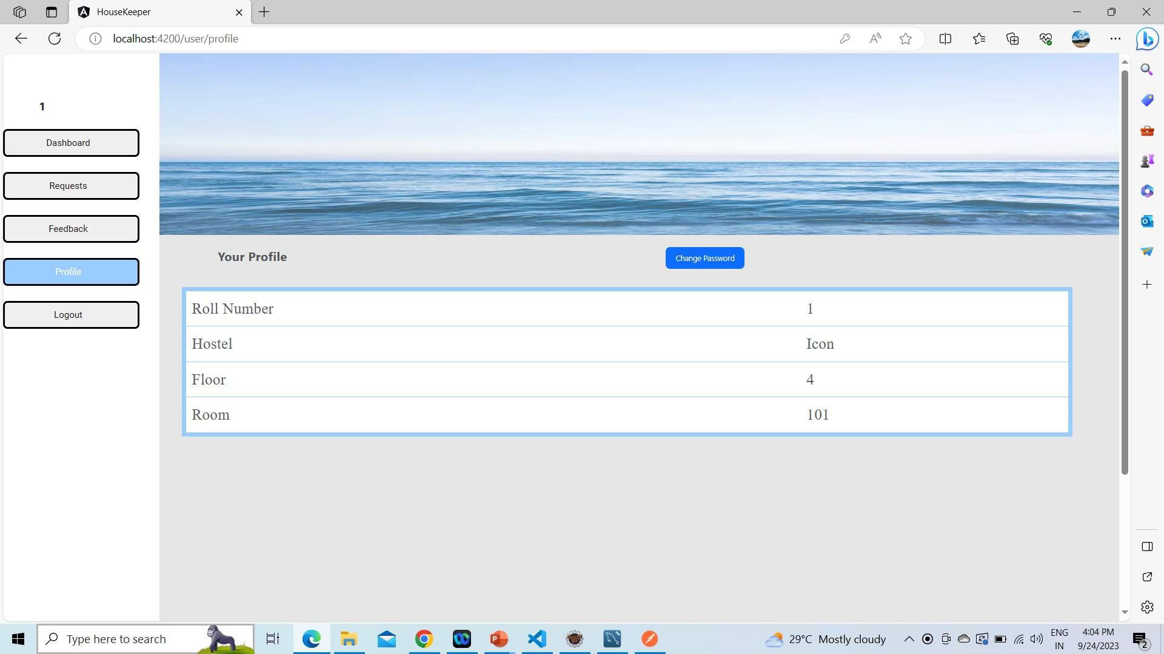

Slide 26
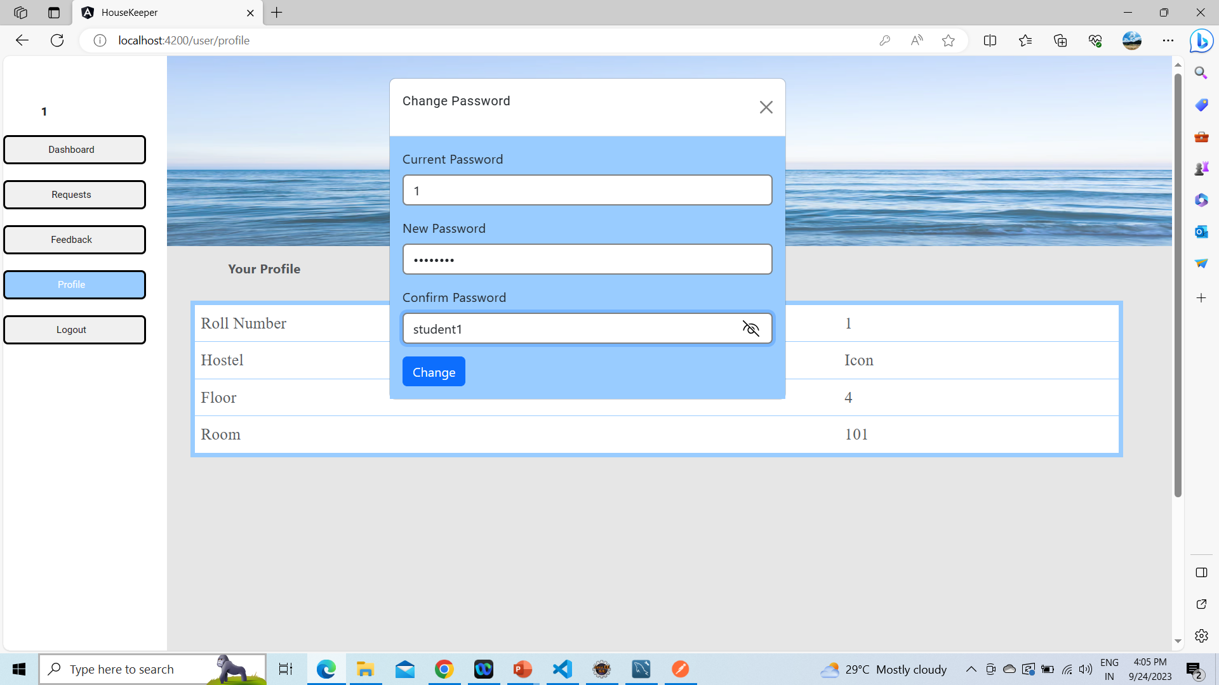

Slide 27
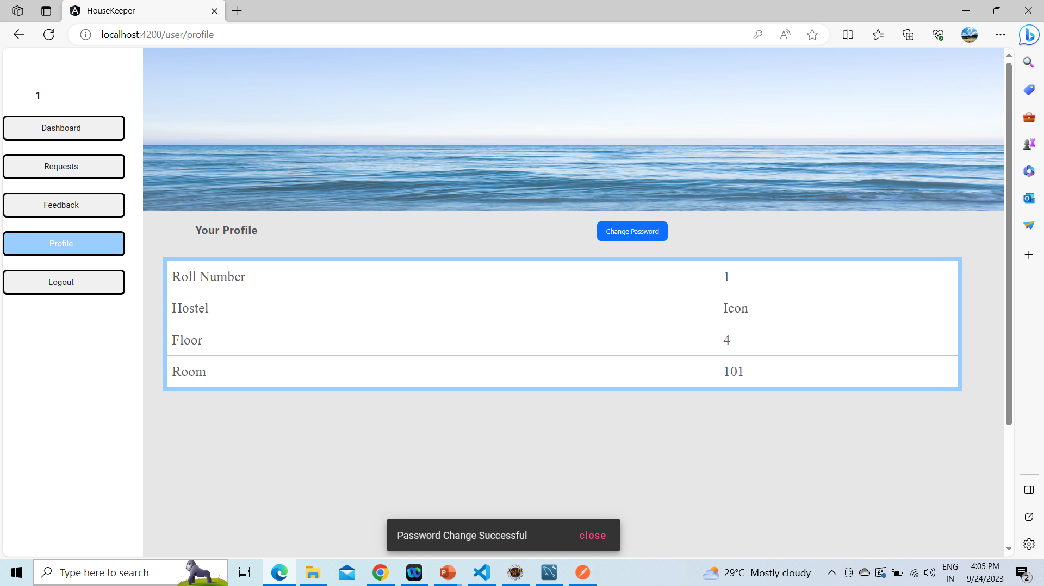

Slide 28
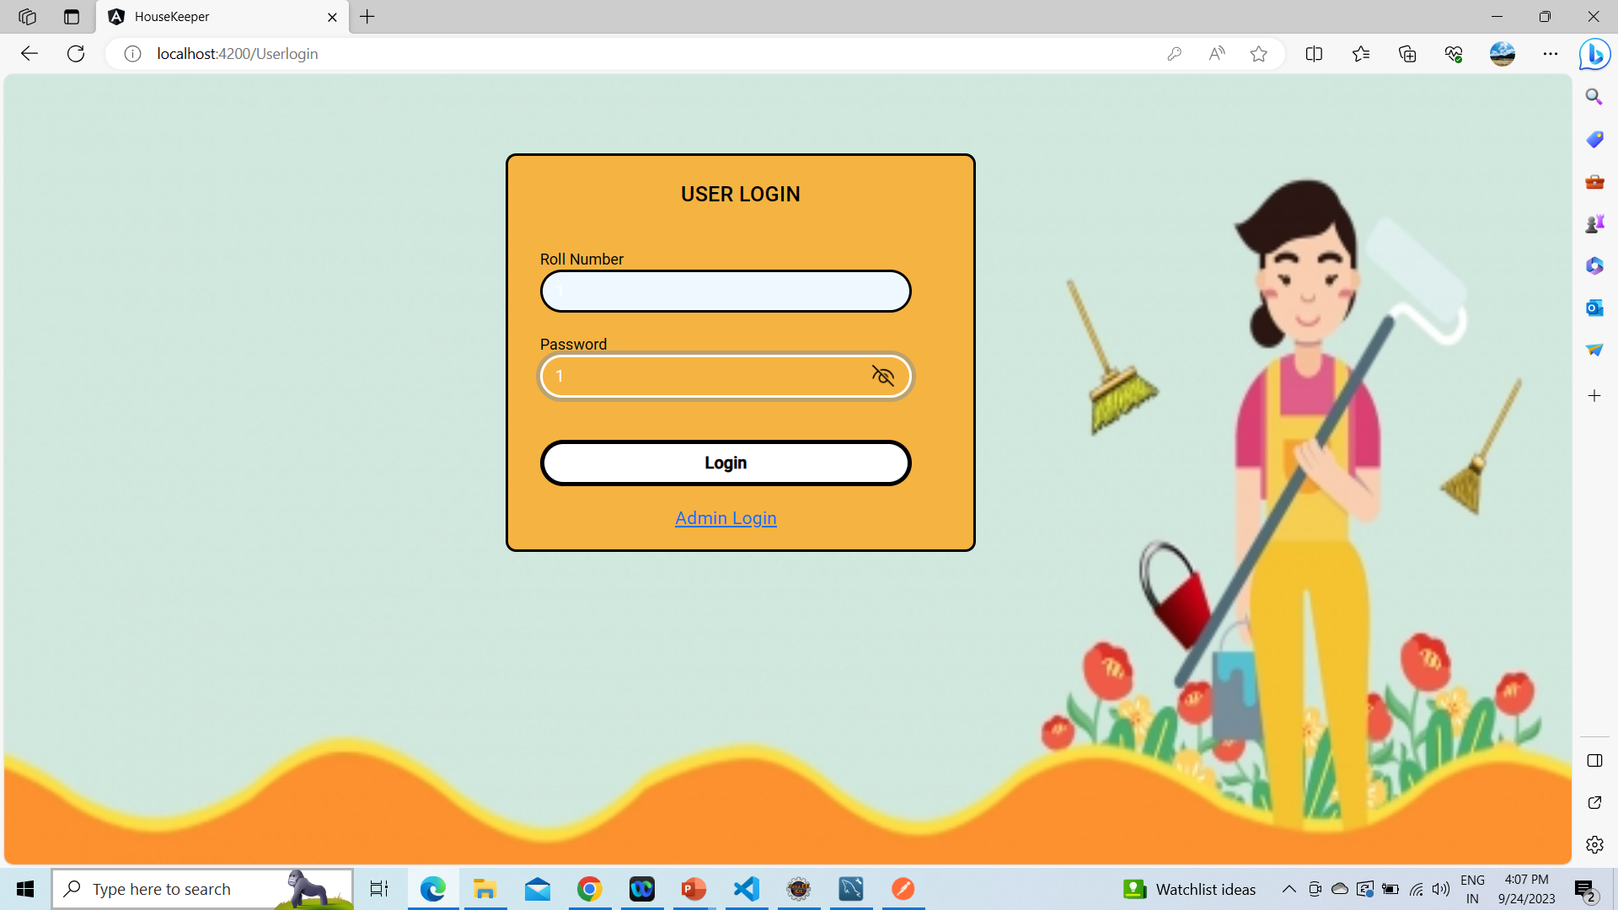
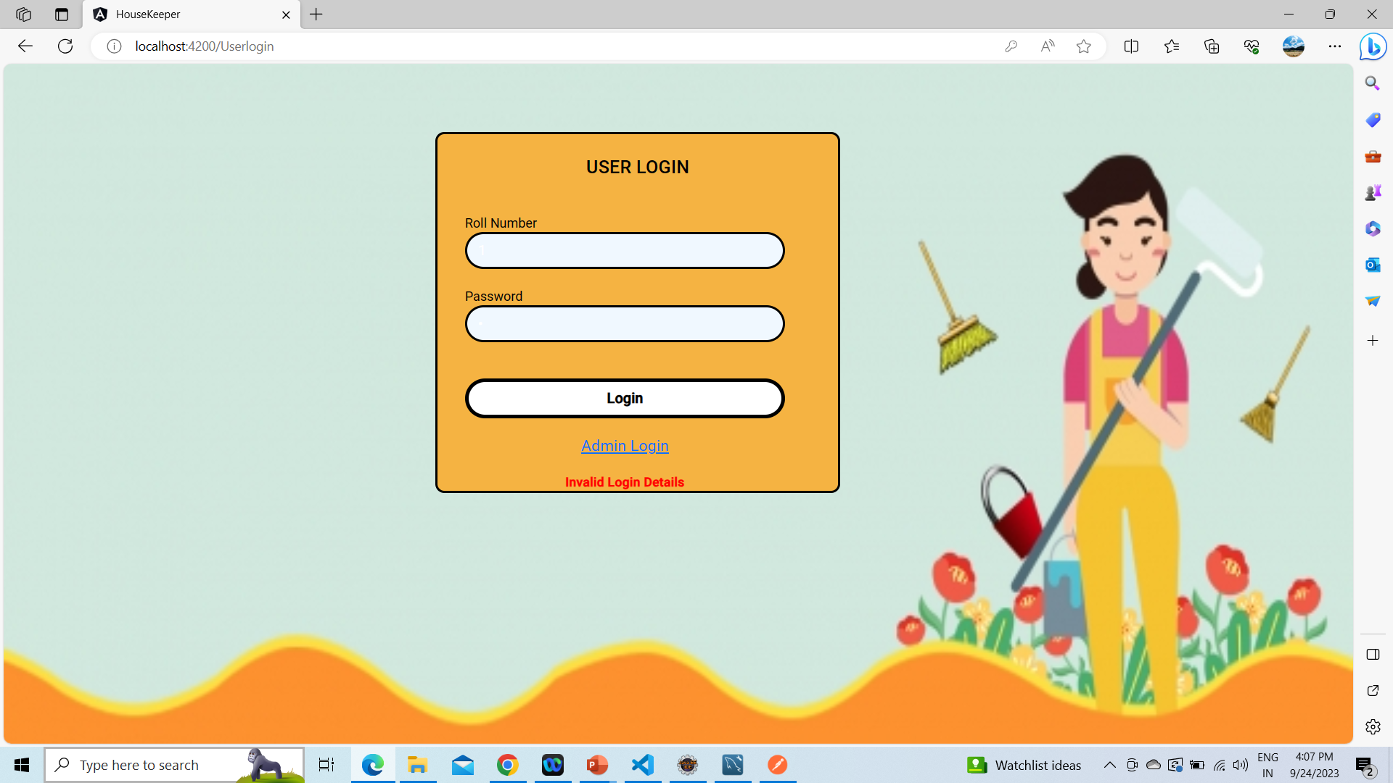

Slide 29


Slide 30
Benefits
For students:
Students will be able to request room cleaning services at their convenience.
They will be able to track the status of their requests in real time.
They will be able to provide feedback on the housekeeping services received.
For Hostel management:
Hostel management will be able to streamline the process of scheduling cleaning services.
They will be able to track the performance of housekeepers.
They will be able to collect feedback from students on the housekeeping services provided.

Slide 31
Future scope
We are eager to improve this project by including the Connection functionality as well as the complete functionality of releasing a housekeeper for a set amount of time or sorting the list of housekeepers according to their availability.

Slide 32
Conclusion
An online housekeeping scheduling system is a valuable asset for both hostel students and hostel management.
It facilitates seamless communication, transparent feedback mechanisms, and efficient allocation of housekeepers, ultimately enhancing the quality of life for students in hostels.

Slide 33
Thank You

